Slide 1
Describe this photo
Notes:
Aim: to set the scene for the short listening to follow. To describe a place from your past.
Script: Describe what you can see. A typical suburban street. What do you call a road which goes round in circle? A roundabout. And the building on the corner where you can see the doorway? That was once a bank. Can anyone guess where this is?

Slide 2
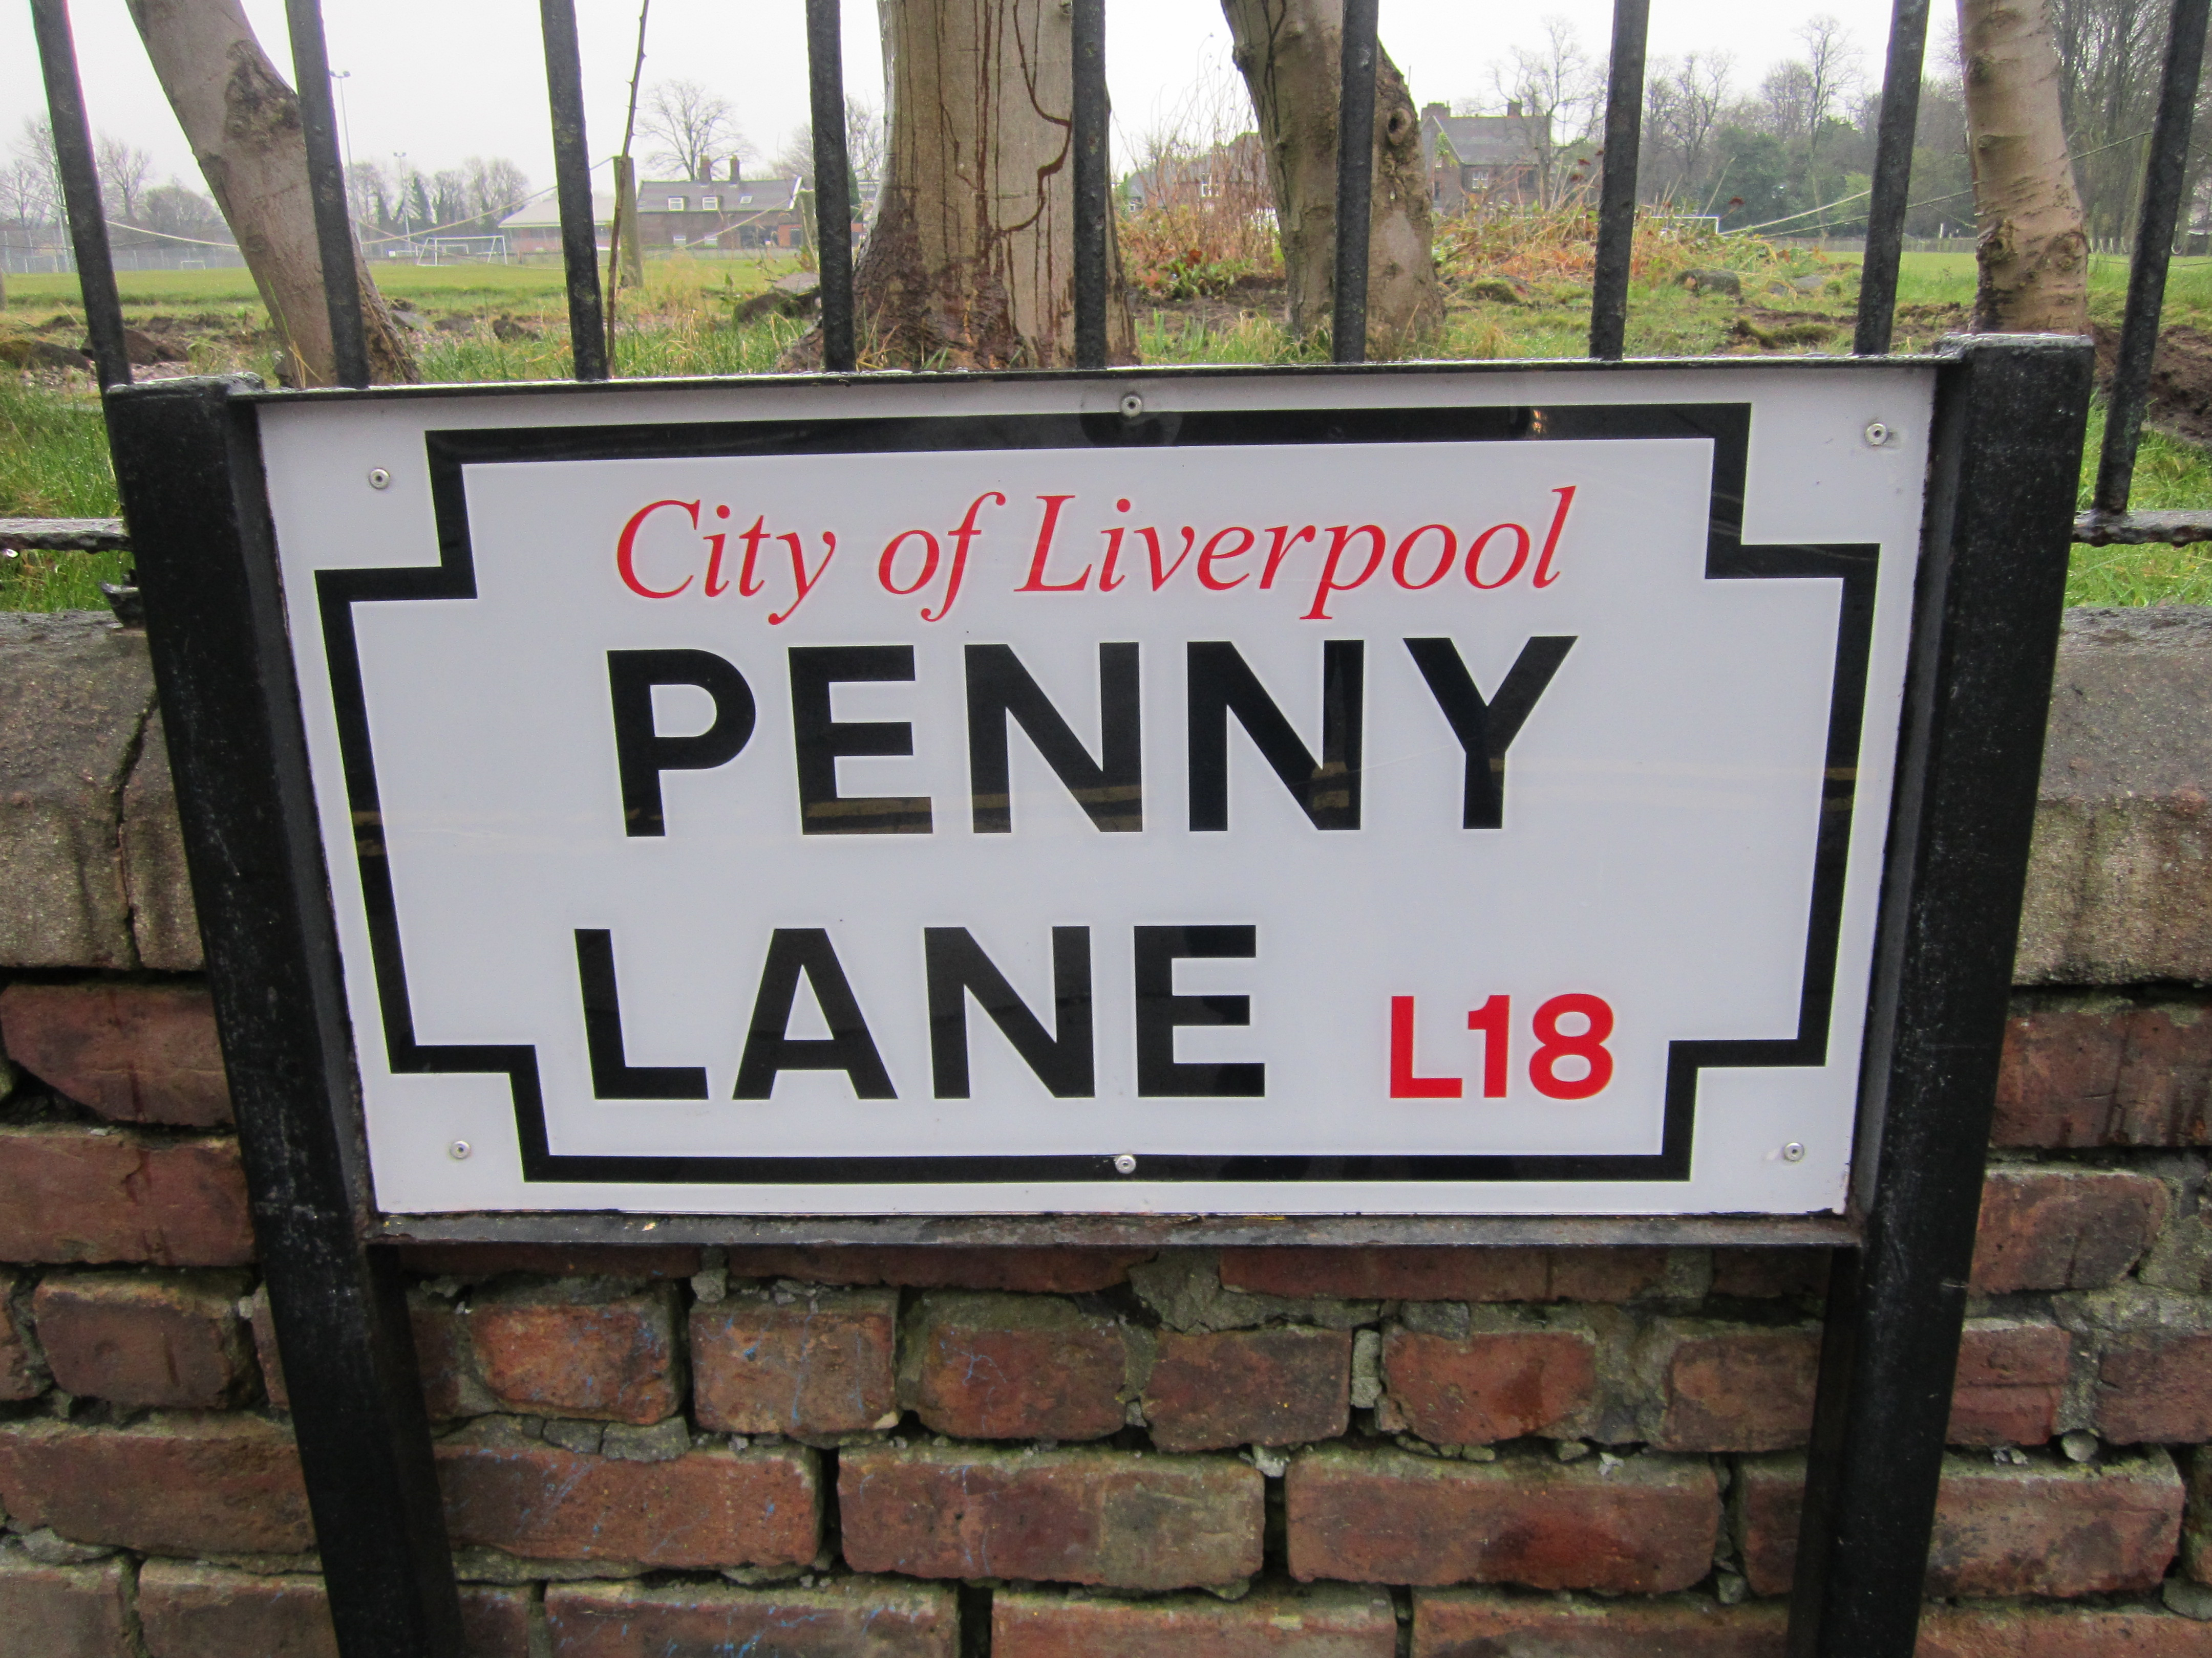
Notes:
Script: What is this? Where does it come from? Why is it famous? Does anyone know the song? Any of the words? The song was written by Paul McCartney – what do you think it is about? What reason might he have had for writing about a road in Liverpool? Perhaps he was thinking about his childhood. Does anyone know a word for this? The word we sometimes use for happy memories of the past is ‘nostalgia’.
(NB. many learners may think they know the words or at least the opening line. But you will probably find that most struggle to accurately recall the lyric. However, if you have a Beatles expert you may have to issue a spoiler alert!

Slide 3
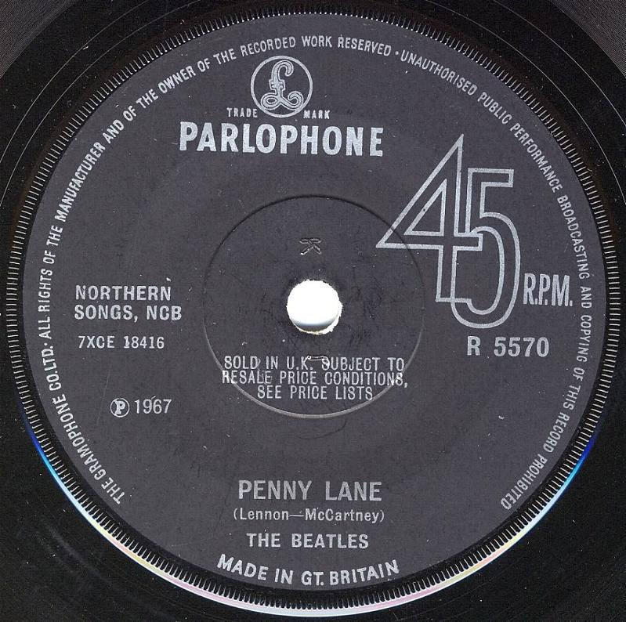
Notes:
Script: Look at the picture. What can you see? This is what we call (called!) a single. A single is small circle of vinyl like this (use prop if you have access to one). How many songs on a single? One? Does everyone agree? Well, it’s actually two songs – the main song usually called the A side and another song on the back called the B side. Usually the A side would be the one you would hear on the radio, the more commercial song that people would want to buy. But here The Beatles broke another old rule by having what became know as a double A side – Penny Lane written by Paul McCartney and Strawberry Fields written by John Lennon.
Look closely at the label. Can you see that it says 45 RPM? Does anyone know what this means? No? Well, RPM stands for Revs Per Minute, the speed the record goes round the turntable. Albums went round at 33 RPM. Can you see which year this record was released? 1967 – just before the famous Sergeant Pepper album was released. And the record company or label? Parlophone.

Slide 4
Notes:
Aim: skim listening for gist.
Script You are going to hear the opening of PENNY LANE. Listen the first time to see what you can understand. The words start from the first note.
Elicit some general answers but avoid confirming details at this stage

Slide 5
Listen again. Write the answers to these questions.
Which two occupations are mentioned?
Who shows photos of customers in his shop?
What is the weather like?
Who is laughing?
Who doesn’t wear a rain coat?
What colour is the sky? Why is it ‘suburban’?
Notes:
Teaching Note: students could either work individually or in pairs but discourage the more confident ones from shouting out answers.
Answers:
Which two occupations are mentioned? Barber and banker
Who shows photos of customers in his shop? The barber
What is the weather like? Pouring rain
Who is laughing? The children
What colour is the sky? Why is it ‘suburban’? Blue sky which is suburban because it is over a suburban area of Liverpool.
Lyric
In Penny Lane there is a barber showing photographs
Of every head he's had the pleasure to know
And all the people that come and go
Stop and say hello
On the corner is a banker with a motorcar
The little children laugh at him behind his back
And the banker never wears a mack
In the pouring rain, very strange
Penny Lane is in my ears and in my eyes
There beneath the blue suburban skies

Slide 6
Grammar
Penny Lane there is a barber showing photographs
Of every head he's had the pleasure to know.
Notes:
Aim: grammar revision: (intermediate+) use of present perfect combined with present progressive.
Script:
Look at the opening line. Which tense is used? Elicit answer Present continuous. When do we use present continuous? Elicit answer The action is happening now (if you go into the barbers you will see his photos
Look at the second line. Which tense is used? Elicit answer Present perfect. Why? Elicit answer. The barber began showing photographs at some time in the past and continues show them now. He will continue to show photos into the future.

Slide 7
Advanced grammar
{ }Penny Lane there is a barber showing photographs.
Of every head he's had the pleasure to know.
Notes:
Aim:(Advanced) How short formats (e.g. texts, modern song lyrics etc.) can result in ‘incorrect’ grammar.
Script:
Song lyrics sometimes do no follow grammatical rules.
Can you see two examples of ‘incorrect’ grammar? They come at the beginning of the first line and the end of the second. What is missing at the beginning of line one?
Elicit answer if students can work it out. You could add that there is a missing preposition.
In normal speech we would say In Penny Lane. In fact an English speaker subconsciously adds the missing ‘in’ to make the lyric work grammatically. We often do this in texting, too, particularly with articles and prepositions e.g. See @cafeé 8.30

Slide 8
Extension activities: Writing
Either:
a)Write about a street that you know.
‘In {your chosen street} there is a ....
or
b) You are either the banker or the barber. Write about a typical day in your life
Notes:
Adapt to level – option a) perhaps the more obvious choice lower levels.
a) encourage students to choose a street where there are local shops etc.
b) This is a chance for students to use their imaginations in the spirit of The Beatles lyrics of this era. They can invent any details they feel appropriate. The model is The Sunday Times feature ‘A Day in the Life’ – see here: http://www.stephenwiltshire.co.uk/archive_article.aspx?Id=2786

Slide 9
Extension activities: Listening/Writing/Speaking
3. Watch this promotional film made for PENNY LANE in 1967. Write down:
three things that are in the film but not the song.
three things that are in the song but not the film.
A place you saw on Slide 1 of this powerpoint!
Notes:
Teaching Notes: Have video set up in separate browser: https://youtu.be/S-rB0pHI9fU
The promotional film that The Beatles made for Penny Lane (and Strawberry Fields) is an early prototype for the modern pop video.
It also marks a major change of image - from clean-cut young family entertainers to grumpy hipsters with moustaches.
Mysteriously, The Beatles also ride horses and wear hunting jackets
Your students might be amused to know that they are not actually seeing the real Penny Lane. It was filmed in north London, near Abbey Road (the roundabout does look very similar though).
Answers:
a) three things that are in the film but not the song. The Beatles (lookng cold and bored) horses, hunting, a strange picnic, the countryside etc.
b) three things that are in the song but not the film. Pouring rain, a banker, a fire engine (though there is what looks like a Victorian fireman on a horse) children, ‘blue suburban skies’ (they are grey and urban and later rural) a portrait of the queen etc.
c) Somewhere you saw on Slide 1 of this powerpoint! The roundabout that inspired PENNY LANE though this was probably not where they filmed.

Slide 10
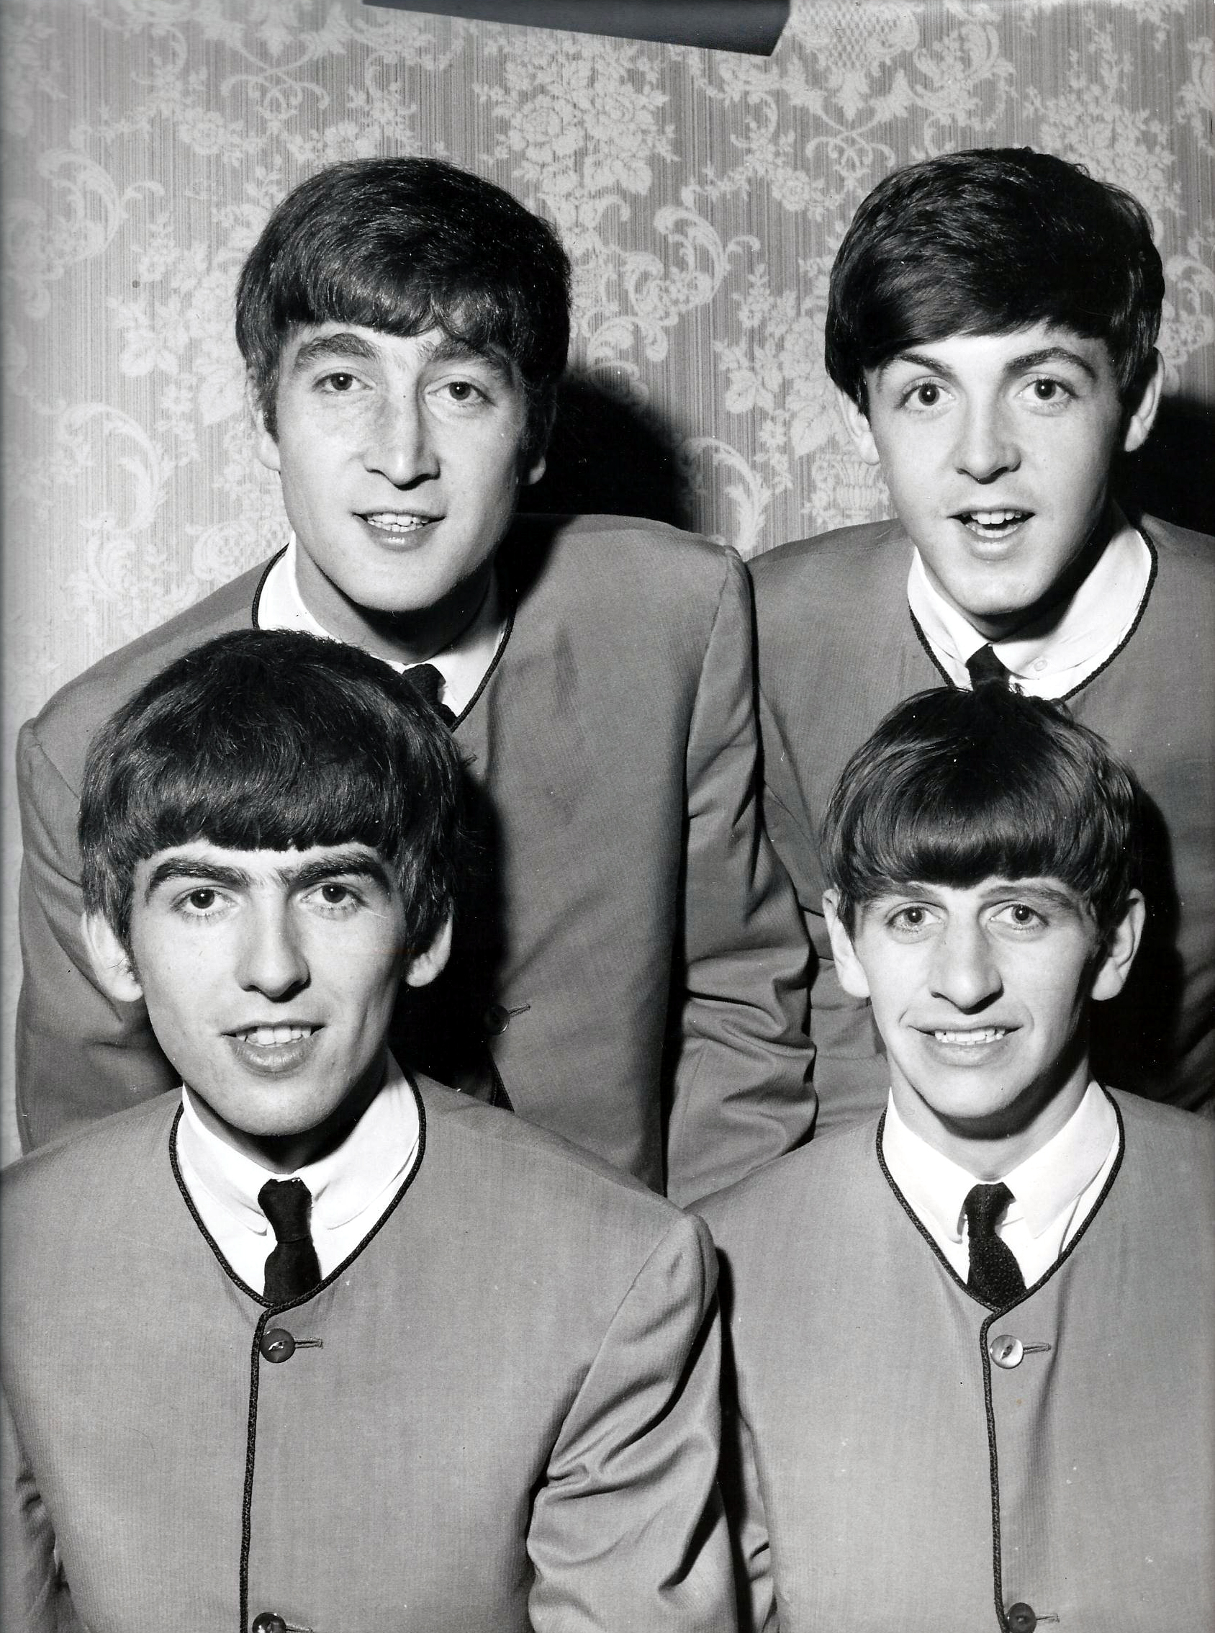
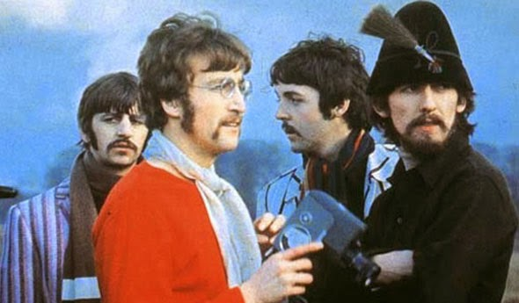
1967
1963
Notes:
Aim: to talk about appearance & image/to describe difference/change/talk This activity can be adapted to level, with lower levels focussing on the physical differences and higher ones covering themes like age, attitudes, inter-personal relations etc. (and the word count adjusted accordingly). You could prepare the task by introducing eliciting/introducing these themes:
Script: Look at these two photos. The one on the left is from 1963. The one on the right is on the set of the promotional film made for STRAWBERRY FIELDS in 1967. How are they different?
Elicit responses that could include:
Colour v Black & White (old to new/traditional to modern)
They stop wearing suits and dress differently.
They start the ‘hipster’ look (though with moustaches rather then beards!)
They appear less cheerful/relaxed
They no longer smile for the camera
They look like their new music – less formal, more experimental and rebellious
Script:
Work in pairs. Each partner talks about one of the photo on the slide.
Describe one you can see to your partner.
Ask your partner about his/her photo: e.g. ‘In my image The Beatles are wearing ties? What about in yours? No, in mine they are all wearing different clothes.
Before you start let’s all practise rising intonation. Repeat after me, ‘What about in yours?’ Remember that the stress comes on ‘yours’.

Slide 11
Taken from
The Beatles Teaching Pack
Notes:
A good way to finish the class is to play the opening one more time – also helps to reinforce new vocabulary etc.
Direct to this cloze activity: http://tiny.cc/5z69fy
They could also complete the Penny Lane Listening Comprehension Quiz here: http://tiny.cc/vl69fy

